Slide 1
Lecture #1a: Introduction to S109a

Slide 2
Lecture Outline
What is Data Science?
What is This Class?
The Data Science Process
Example

Slide 3
What is Data Science?

Slide 4
Why?
Jobs!

Slide 5
Why?
Jobs demand

Slide 6
Why?
Jobs supply

Slide 7
Why?
Jobs:
By 2018, the US could face a shortage of up to 190,000 workers with analytical skills
McKinsey Global Institute
The sexy job in the next 10 years will be statisticians.
Hal Varian, Prof. Emeritus UC Berkeley Chief Economist, Google

Slide 8
How?
Long time ago (thousands of years) science was only
empirical and people counted stars

Slide 9
How?
Long time ago (thousands of years) science was only
empirical and people counted stars or crops

Slide 10
How?
Long time ago (thousands of years) science was only
empirical and people counted stars or crops and used the data to create machines to describe the phenomena

Slide 11
How?
Few hundred years: theoretical approaches, try to derive
equations to describe general phenomena.

Slide 12
What is this class?

Slide 13
What?

Slide 14
What?
The material of the course will integrate the five key facets of an investigation using data:
data collection; data wrangling, cleaning, and sampling to get a suitable data set
data management; accessing data quickly and reliably
exploratory data analysis; generating hypotheses and building intuition
prediction or statistical learning
communication; summarizing results through visualization, stories, and interpretable summaries.

Slide 15
What?
First week:
Getting ready with python, jupyter notebooks, some basic statistics, matplotlib (viz) and numpy.
Lectures during this week will be lab-like.

Slide 16
What?
Second and third week:
Regression, Transportation Data, Basic Visualization and sklearn:
knn regression
Linear and Polynomial Regression
Multiple Regression
Model Selection
Regularization

Slide 17
What?
Fourth and fourth week:
Classification, Health Data, Keras and Presentations Stack:
Logistic Regression (linear and polynomial)
Multiple Logistic Regression
Discriminant analysis (LDA and QDA)
Classification with decision trees
Missing data and knn classification
Perceptron, backpropagation and gradient descent

Slide 18
What?
Fifth and sixth week:
Ensemble Methods, Natural Science data, Web Site Building and Report Writing
Random Forest
Bagging
Boosting
Stacking
Support Vector Machine
Neural Networks, Multilayer Perceptron

Slide 19
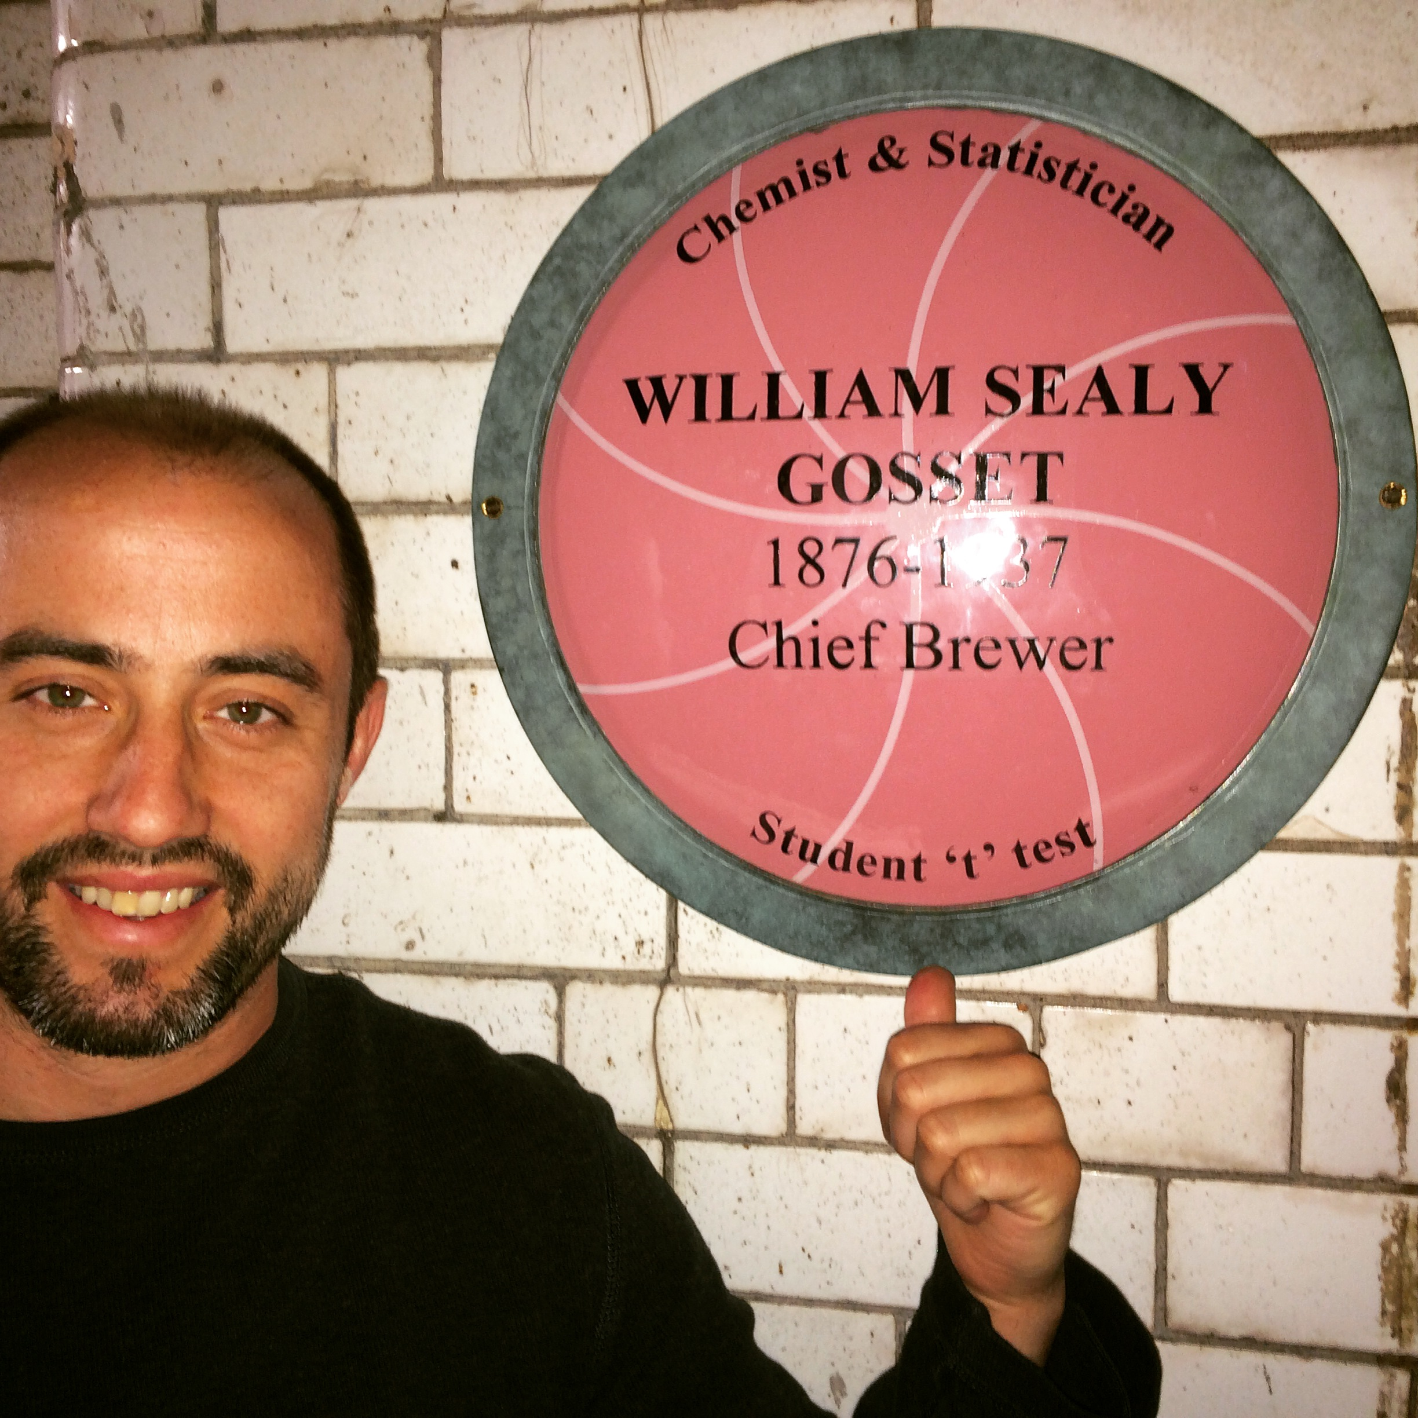
Who?
Kevin Rader
Senior preceptor in Statistics. Teaches CS 109A & Stat 139 this fall and Stat 102 and Stat 98 in the spring.
Research interests include complex survey analysis and causal inference. Hobbies include the outdoors, sports
(especially the aquatic variety), and of course, farming.

Slide 20
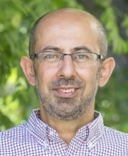
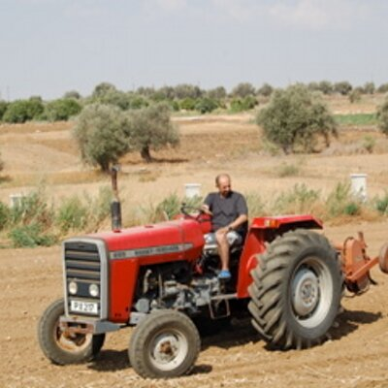
Who?
Pavlos Protopapas
Scientific Director of the Institute for Applied Computational Science (IACS)
Teaches CS109(a/b) and the Capstone course for the Data Science masters program.
Research in astrostatistics and he is excited about the new telescopes coming online in the next few years. He has absolutely no hobbies or interests except teaching CS109 and eating.

Slide 21

Who?
(Head TF) Sol Girouard:
She has been a Teaching Fellow for 109a/b, while a Top of Class and Award Wining Student graduating as part of Harvard Class of 2018.
She is a Quant, Mathematical Economist and Data Scientist who channels her applied interdisciplinary background in the intersection of financial markets and technology.

Slide 22
Teaching Fellows
Nicholas Ruta (assistant Head TF)
David Sondak (Lab Leader)
Will Claybaugh (Lab Leader)
Patrick Ohiomoba
Brandon Walker
Joe Palin
Evan MacKay
Richard Kim

Slide 23
Lectures, Labs, Office hours
Lectures:
Mondays and Wednesdays 12:00-3:0pm @Northwest Building B108.
During lecture will cover the material which you will need to complete the homework, midterms and to survive the rest of your life. Attending lectures is required - quizzes at the end of each lecture (drop 40% of them) .
We will use a mix of notes and examples via notebooks
Lecture notes and associated notebooks will be posted before lecture on Canvas and on GitHub.
Lectures will be video taped (and live streamed) and posted approximately within 24 hours on Canvas.

Slide 24
Lectures, Labs, Office hours
Labs:
Fridays 12:00-3:00pm @Northwest Building B108.
Labs are meant to help you understand the lecture materials better via examples.
Labs will be video taped (and live streamed) and posted approximately within 24 hours on Canvas

Slide 25
Office hours
 | ONLINE | ON CAMPUS | ONLINE ON CAMPUS | 9/7 | 9/8 | 9/9 | 9/10
 | 9/4 | 9/5 | 9/6 | XX
 | MONDAY | TUESDAY | WEDNESDAY | THURSDAY | FRIDAY | SATURDAY | SUNDAY
9:00 AM |  |  |  | 9-10 NICK
9:30 AM
10:00 AM |  |  |  |  |  |  | JOE
10:30 AM |  |  |  | 10-11 EVAN
11:00 AM
11:30 AM
12:00 PM |  |  |  |  |  |  | WILL
12:30 PM
1:00 PM
1:30 PM
2:00 PM
2:30 PM
3:00 PM | 3-4:30 KEVIN |  |  |  | DAVID MD G-111
3:30 PM
4:00 PM
4:30 PM
5:00 PM | 4:30-6 PAVLOS MD G-109 | 5-6 RICHARD
5:30 PM
6:00 PM |  | 6-7 SOL
6:30 PM | 6-7 PATRICK
7:00 PM
7:30 PM
8:00 PM | BRANDON
8:30 PM
9:00 PM

Slide 26
Homework(s)
There will be 6 homework (not including Homework 0):
Homework 0 (due tomorrow)
Homework 1: Web scraping, RegExp, Beautiful Soup
Homework 2: Regression kNN and LinReg
Homework 3: Multi-regression, polynomial reg. and model selection
Homework 4: Regularization and CV
Homework 5: LogReg, LDA and QDA
Homework 6*: Random Forest, Boosting and Neural Networks

Slide 27
Homework(s)
You are encouraged but not required to submit in pairs, except homework 6, which must submit individually.
We will be using the Groups function in Canvas to do this, details to be announced later.
All homework are due 11:59pm Tuesday and homework will be released on Tuesday 5:00pm.
Late Days:
You are allowed up to 3 days of late homework submissions, maximum of 1 day on any single assignment, no questions asked. Late homework submissions will not be accepted after 24 hours past the due date. If you exceed your 3 late days, 1 point (20%) will be deducted for late days after that.

Slide 28
Final Project
There will be a final group project (2-4 students) due during exams period.
We will provide 5 pre-defined projects which you could use for your final project.
In some very special cases you can use your own (public) data set and your own project definition (to be approved by the instructors)

Slide 29
Final Project
Puppies: Using images of puppies, create an image classification system for the classification of pure dog breeds.
LendingClub: Using loan applications and payment histories available online, create a fair model to determine a loan recipients ability to repay their loan.
Spotify: Using data available from Spotify, create a Music Recommendation System to suggest songs for users to add to a playlist.
Twitter: Using available tweet data, create a Twitter Bot Detection algorithm to determine whether a tweet was posted by an actual user or an automated bot.
Weather: Using data from published academic project and what is publicly available on weather forecasting websites (like weather underground), build a model for describing patterns over time and predicting meteorological and oceanic temperatures.

Slide 30
Help

Slide 31
Help
The process to get help is:
Post the question in Piazza and hopefully your peers will answer. We monitor the posts and we will respond within 8 hours from the posting time.
Go to Office Hours, this is the best way to get help.
For private matters send an email to the Helpline: cs109a2018summer@gmail.com. The Helpline is monitored by all the instructors and TFs.
For personal matters send an email to Pavlos and/or Kevin
All teaching staff are off on Saturdays!

Slide 32
Grades

Slide 33
Grades
Paired Homeworks: 45%
Individual Homework: 15%
Quizzes: 15%
Project: 25%
Total: 100%
We do not have predefined cuts for grades. We look for breaks in the cumulative distribution.

Slide 34
The Data Science Process

Slide 35
The Data Science Process
The Data Science Process is similar to the scientific process - one of observation, model building, analysis and conclusion:
Ask questions
Data Collection
Data Exploration
Data Modeling
Data Analysis
Visualization and Presentation of Results
Note: This process is by no means linear!

Slide 36
Analyzing Hubway Data
Introduction: Hubway is metro-Boston’s public bike share program, with more than 1600 bikes at 160+ stations across the Greater Boston area. Hubway is owned by four municipalities in the area.
By 2016, Hubway operated 185 stations and 1750 bicycles, with 5 million ride since launching in 2011.
The Data: In April 2017, Hubway held a Data Visualization Challenge at the Microsoft NERD Center in Cambridge, releasing 5 years of trip data.
The Question: What does the data tell us about the ride share program?

Slide 37
The Data Exploration/Question Refinement Cycle
Our original question: ‘What does the data tell us about the ride share program?’ is a reasonable slogan to promote a hackathon. It is not good for guiding scientific investigation.
Before we can refine the question, we have to look at the data!
Based on the data, what kind of questions can we ask?

Slide 38
The Data Exploration/Question Refinement Cycle
Who? Who’s using the bikes?
Refine into specific hypotheses:
More men or more women?
Older or younger people?
Subscribers or one time users?

Slide 39
The Data Exploration/Question Refinement Cycle
Where? Where are bikes being checked out?
Refine into specific hypotheses:
More in Boston than Cambridge?
More in commercial or residential?
More around tourist attractions?
Sometimes the data is given to you in pieces and must be merged!

Slide 40
The Data Exploration/Question Refinement Cycle
When? When are the bikes being checked out?
Refine into specific hypotheses:
More during the weekend than on the weekdays?
More during rush hour?
More during the summer than the fall?
Sometimes the feature you want to explore doesn’t exist in the data, and must be engineered!

Slide 41
The Data Exploration/Question Refinement Cycle
Why? For what reasons/activities are people
checking out bikes?
Refine into specific hypotheses:
More bikes are used for recreation than commute?
More bikes are used for touristic purposes?
Bikes are use to bypass traffic?
Do we have the data to answer these questions with reasonable certainty?
What data do we need to collect in order to answer these questions?

Slide 42
The Data Exploration/Question Refinement Cycle
How? Questions that combine variables.
How does user demographics impact the duration the bikes are being used? Or where they are being checked out?
How does weather or traffic conditions impact bike usage?
How do the characteristics of the station location affect the number of bikes being checked out?
How questions are about modeling relationships between different variables.

Slide 43
Inspirations for Data Viz/Exploration
So how well did we do in formulating creative hypotheses and manipulating the data for answers?
Check out the winners of the Hubway Challenge:
http://hubwaydatachallenge.org

